Slide 1
CHAPTER 5
Multivariate Probability Distributions

Slide 2
OBJECTIVES
Independent Random Variables
Conditional Distributions

Slide 3
Independent Random Variables

Slide 4
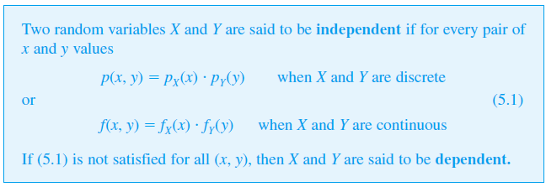
Independent Random Variables
In Chapter 2, we pointed out that one way of defining independence of two events is via the condition
P(A ∩ B) = P(A)  P(B).
Here is an analogous definition for the independence of two rv’s.

Slide 5
Independent Random Variables
The definition says that two variables are independent if their joint pmf or pdf is the product of the two marginal pmf’s or pdf’s.
Intuitively, independence says that knowing the value of one of the variables does not provide additional information about what the value of the other variable might be.
Independence of two random variables is most useful when the description of the experiment under study suggests that X and Y have no effect on one another.
Then once the marginal pmf’s or pdf’s have been specified, the joint pmf or pdf is simply the product of the two marginal functions. It follows that
P (a ≤ X ≤ b, c ≤ Y ≤ d) = P (a ≤ X ≤ b)  P (c ≤ Y ≤ d)

Slide 6
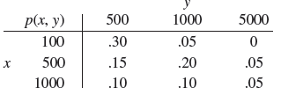
Example
X =the amount of the auto policy deductible and
Y = the amount of the homeowner policy deductible
p(1000, 5000) = .05 ≠ (.25)(.10) = p_{X}(1000)  p_{Y}(5000)
so X and Y are not independent.
Independence of X and Y requires that every entry in the joint probability table be the product of the corresponding row and column marginal probabilities.

Slide 7
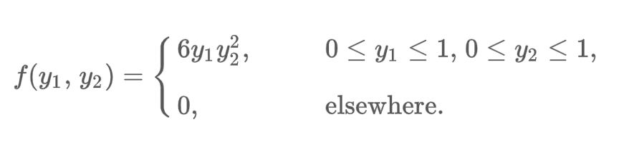
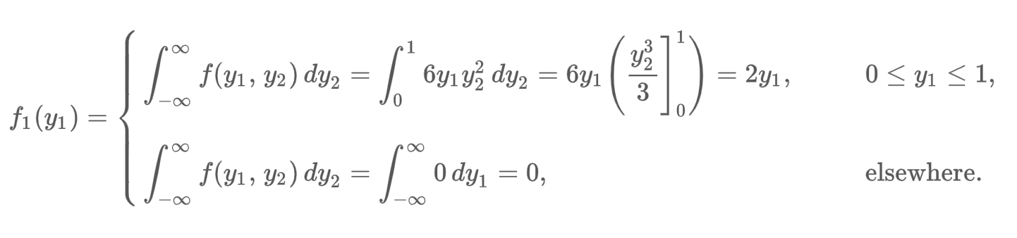
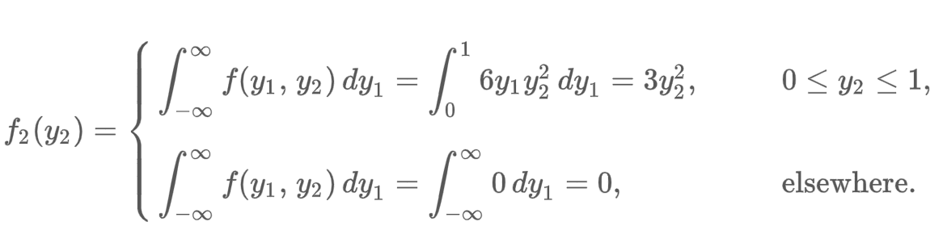
Example
Are Y₁ and Y₂ independent?
Sol:
Hence, f(y₁, y₂) = f₁(y₁) . f₂(y₂) for all real numbers (y₁, y₂), therefore, Y₁ and Y₂
are independent.

Slide 8
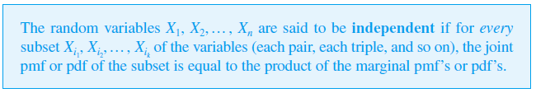
More Than Two Random Variables
The notion of independence of more than two random variables is similar to the notion of independence of more than two events.
Most importantly, once we are told that n variables are independent,
then the joint pmf or pdf is the product of the n marginals.

Slide 9
Conditional Distributions

Slide 10
Conditional Distributions
Suppose X = the number of major defects in a randomly selected new automobile and Y = the number of minor defects in that same auto. If we learn that the selected car has one major defect, what now is the probability that the car has at most three minor defects—that is, what is P(Y ≤ 3 | X = 1)?
Similarly, if X and Y denote the lifetimes of the front and rear tires on a motorcycle, and it happens that X = 10,000 miles, what now is the probability that Y is at most 15,000 miles, and what is the expected lifetime of the rear tire “conditional on” this value of X?
Questions of this sort can be answered by studying conditional
probability distributions.

Slide 11
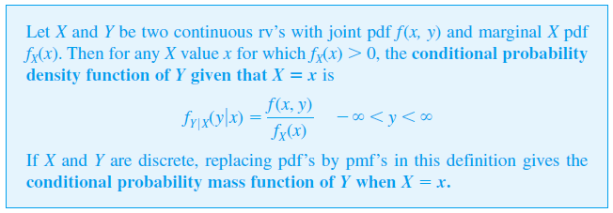
Conditional Distributions
Notice that the definition of f_{Y | X}(y | x) parallels that of P(B | A), the conditional probability that B will occur, given that A has occurred.

Slide 12
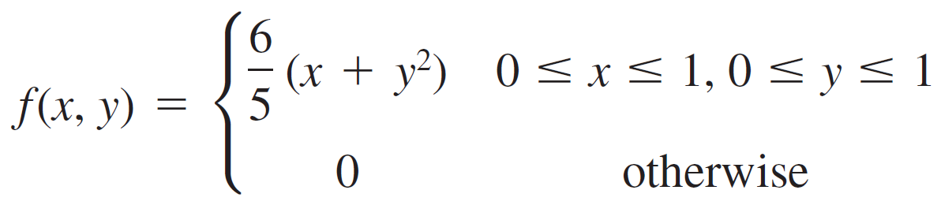
Example
Reconsider the example involving X = the proportion of time that a bank’s drive-up facility is busy
Y = the analogous proportion for the walk-up window.
Q1) Find the conditional pdf of Y given that X = .8.
Sol:

Slide 13
Example cont’d
Q2) What is the probability that the walk-up facility is busy at most
half the time given that X = .8?
Sol:

